Slide 1
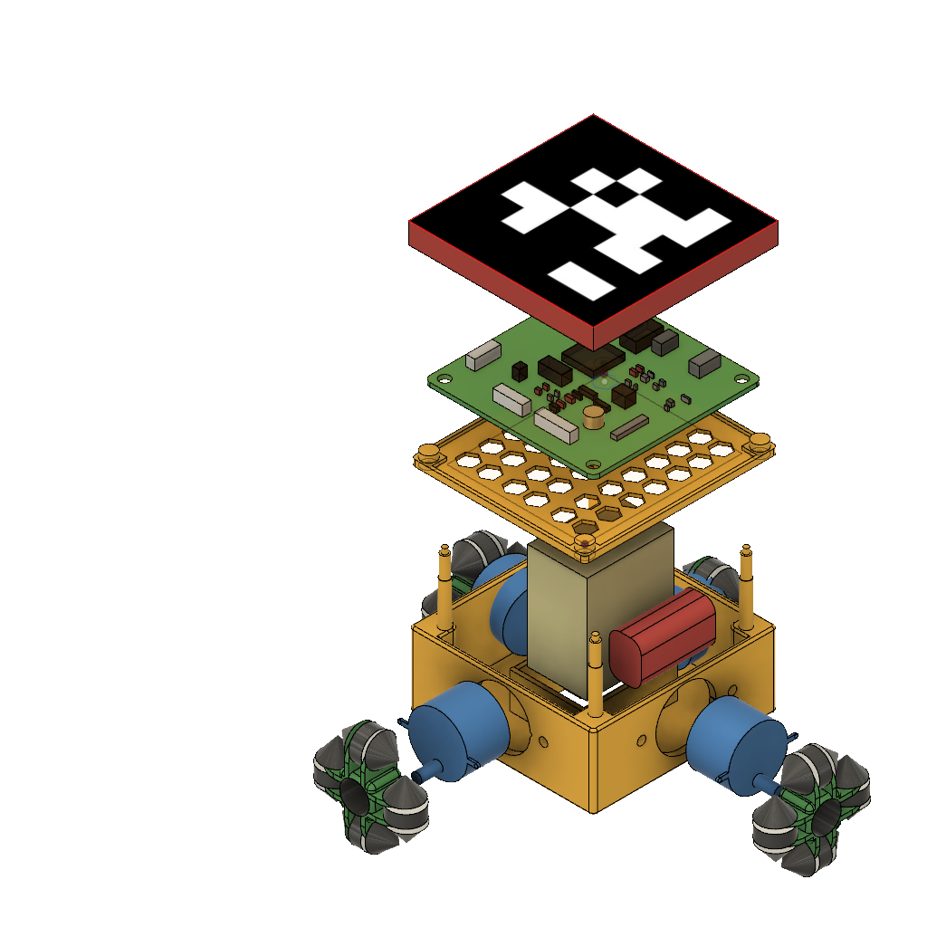

SPRINTER: IoT Based Mobile Printing Robot
Guide: Dr. S. Dhanalakshmi, Dr. R. Kumar

Slide 2
SPRINTER: Design
The SPRINTER is an omni-directional robot. It mainly consists of the following components:
Electronics and controller
Inkjet cartridge and driver
Locomotion system
Power supply
The robot consists of three layers:
First Layer – It is the upper lid of the printer and covers the circuit board beneath it.
Second Layer – It holds the circuit board above the base.
Third Layer – It is the base layer which homes the cartridge, battery and the motors at each side of the base.

Slide 3
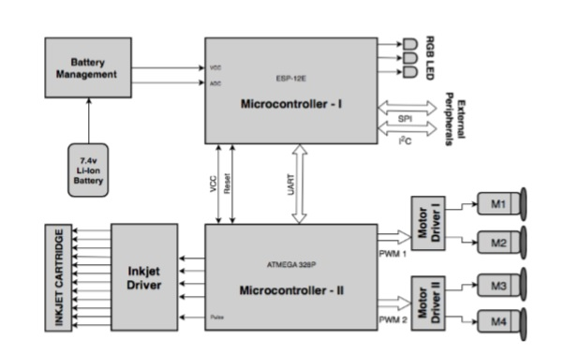
SPRINTER: Electronics

Slide 4
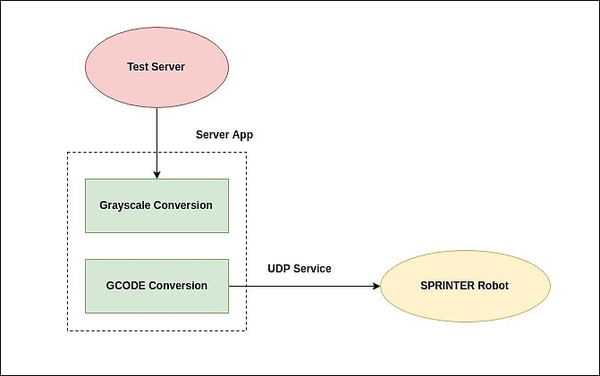
SPRINTER: Working

Slide 5
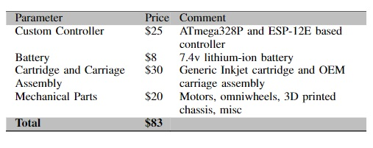
SPRINTER: Cost Analysis

Slide 6
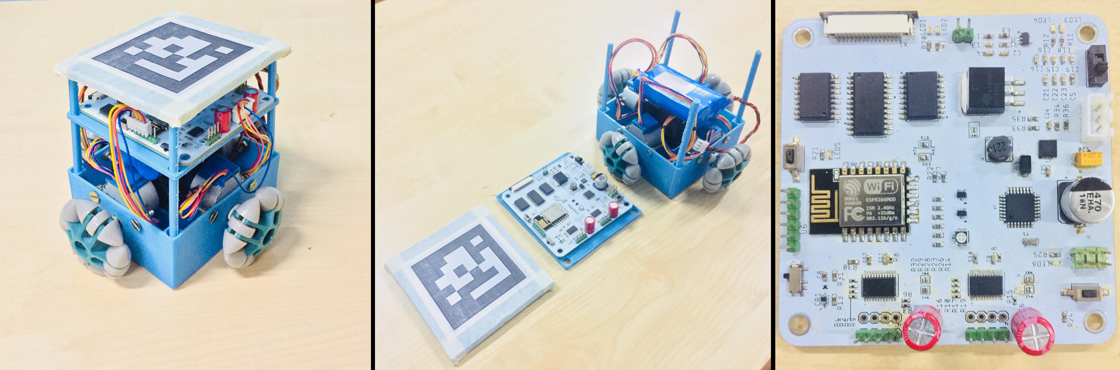
SPRINTER: Prototype
shows the actual SPRINTER robot prototype.
(b) shows the three layers of robot.
(c)shows custom circuit board that controls electronics of the SPRINTER.

